Slide 1
Bardwell Lake Master Plan Revision: Public Involvement Presentation
U.S. Army Corps of Engineers
Fort Worth District
Notes:
Hello, my name is Dylan Mayfield and am the Lake Manager at Bardwell Lake. On behalf of the US Army Corps of Engineers, we would like to welcome you to the Public Involvement Presentation for the master plan revision at Bardwell Lake. Public and stakeholder involvement is critical to the success of the master plan revision. Thank you for taking the time to attend this meeting.
15 September 2022

Slide 2
Purpose of Presentation
Inform the public and stakeholders that a master plan revision has started
Define a master plan
Describe the master plan revision process
Provide instructions on how to participate in the revision process
Encourage participation
Provide links to documents
The Corps defines a Master Plan as…
“The strategic land use management document that guides the comprehensive
management and development of all project recreational, natural and
cultural resources throughout the life of the water resource development project.”
Source: Chapter 3 of EP 1130-2-550 available at
www.usace.army.mil/library/publications
Notes:
The purpose of this presentation is to inform the public and stakeholders that a master plan revision has started at Bardwell Lake. This presentation will define a master plan, describe the master plan revision process, provide instructions on how to participate in the process, and encourage participation. It will also provide links to documents and details about how to contact the Corps to ask questions.
The information provided through public and stakeholder comments is essential to the decision-making process of how project lands and water surfaces will be classified and managed. The Corps wants your ideas and comments. After watching this presentation, review the other material on the project website and send in comments and participate in planning the future of Bardwell Lake.

Slide 3
Presentation Topics
What is a master plan?
Why do a revision?
What is not part of a master plan?
How can I participate?
When will the master plan be done?
Who can I talk to about the plan?
What is the revision process?
What is changing in the plan?
Notes:
Topics to be covered in this presentation are summed up under these 8 questions that are often asked in a public meeting or workshop:
What is a Master Plan?
Why do a revision?
What is the revision process?
What is not part of a Master Plan?
What is changing in the Plan?
How can I participate?
Who can I talk to about the plan?
When will the Master Plan be done?
Under each of these 8 topics, this presentation will provide details to help you better understand the master plan project and your role in the process.

Slide 4
What is a master plan?
The master plan is a 25 year comprehensive land use management guide for recreational, natural, and cultural resources
Adheres to Federal laws to preserve, conserve, restore, maintain, manage, and develop project lands, waters, and associated resources, including the National Environmental Policy Act (NEPA) for environmental stewardship and outdoor recreation
Provides land classifications and resource management objectives that are broad and adaptive over time
Requires and encourages public involvement
Notes:
You might be wondering, what is a master plan?
The master plan is the document that will guide the land use and management of the project for the next 25 years, while adhering to all applicable Federal laws including the National Environmental Policy Act, or NEPA. The focus of the plan is the designation of land classifications with corresponding management plans, as well as establishing resource management objectives.
The key to a successful master plan is public involvement.
Participation, in the form of providing written comments, is how you can help.

Slide 5
Why do a evision?
Why do a revision?
The current master plan is out of date and is no longer compliant with new regulations
Substantial changes in environmental, cultural, social, and recreational conditions have occurred since the current master plan was approved
Re-examine land classification due to these substantial changes
The master plan provides long-term goals and consistent management objectives to guide balanced management of resources and public recreation
Notes:
Why is the Corps doing a revision to the master plan at this time?
The Corps is undergoing master plan revisions at many of their projects nationwide as existing plans are no long compliant with current regulations. Many projects have also been influenced by changes in the surrounding environment, either by increased urbanization and growth, or changes in rural patterns of land use. As change is ever constant, an update to the plan is needed to capture how the project land classifications meet the current and future projected uses. Not only does land use change, but also management resources in terms of personnel over time, the master plan provides stability, with long-term goals, and a consistent management strategy, for project resources.

Slide 6
What is the revision process?
The process is a cover-to-cover review and revision of the entire plan and is accomplished by:
A team of Corps employees including Operations, Real Estate, Master Planning, and Environmental Compliance subject matter experts
Receive input from and collaboration with partners, neighbors, stakeholders, elected officials, resource agencies, and the public
A thorough review and update of land and water surface classifications
Developing appropriate NEPA compliance documents
Notes:
The revision process includes a cover-to-cover review and update of the entire plan. The revision involves input from the public and stakeholders but is compiled and completed by a team of Corps employees from a wide array of disciplines. Operations, Real Estate, Master Planning and Environmental Compliance are a few of the subjects where expertise is needed. The revision process will review all of the land and water surface classifications and recommend changes as appropriate. The revision process is a federal action that requires compliance with NEPA, and the appropriate documentation will be a part of the plan.

Slide 7
What is the revision process?
Project Initiation/Data Collection
Agency/Public Scoping Notification & Comment Period (30* days)
PHASE 1
SCOPING
Development of Draft Master Plan Report and Environmental Assessment (EA)
Agency/Public Draft Document Notification & Comment Period (30 days)
PHASE 2
DRAFT
Development of Final Master Plan Report and EA
Publish Final Master Plan Report and EA
PHASE 3
FINAL
Where we are today
Notes:
The revision process includes 3 phases: (scoping, draft and final)
The scoping phase is when the federal agency asks for initial input from other agencies, citizens and organizations regarding project area, resources and uses. This is the phase we are currently in, as noted by the yellow star on the chart.
The draft phase is when the Corps asks for public comments on the proposed recommendations in the draft master plan document.
The final phase is when the Corps incorporates public comments from the draft review into a final master plan document.
The plan is published after formal approval by the District Commander.

Slide 8
What is the revision process?
Land Classifications
Source: Engineering Pamphlet (EP) 1130-2-550
Land Classification | Definition
Project Operations | Lands required for the dam, spillway, levees, office, maintenance facilities and other areas that are used solely for project operations.
High Density Recreation | Land developed for intensive recreational activities for the visiting public, including day use areas and campground areas for commercial concessions, and quasi-public development.
Multiple Resource Management Lands | Low Density Recreation: Lands with minimal development or infrastructure that support passive public recreational use (e.g., trails, primitive camping, wildlife observation, fishing and hunting).
 | Wildlife Management: Lands designated for the stewardship of fish and wildlife resources.
 | Vegetative Management: Lands designated for the stewardship of forest, prairie, and other native vegetative cover.
 | Inactive and/or Future Recreation Areas: Recreation areas planned for the future or that have been temporarily closed.
Environmentally Sensitive Areas | Areas where scientific, ecological, cultural or aesthetic features have been identified. These areas must be considered by management to ensure they are not adversely impacted.
Mitigation | Lands acquired or designated specifically for offsetting losses associated with development of the project. Lands allocated as separable mitigation lands can only be given this classification.
Notes:
The Corps defines land classification as the primary use for which project lands are managed. All Federally owned lands are zoned for development and resource management consistent with project purposes.
Utilizing the current Federal guidance, the land classifications are defined as shown in this table.
The Project Operations classification is used solely for lands dedicated for the operation of the project, including the dam, spillway, levees, project office, and other operational features.
The classification High Density Recreation is assigned to lands that are being used for intensive recreational activities, including day use and campground areas.
The Multiple Resource Management Lands allows for the designation of a predominate use and are subdivided into 4 classifications. All 4 classifications essentially allow for similar activities to occur, but are managed with a particular emphasis, including low density recreation, wildlife management, vegetative management, and inactive or future recreation areas.
The protection of Environmentally Sensitive Areas is given priority, and are for lands with unique scientific, ecological, cultural, or aesthetic features. Examples include endangered species habitat, scenic shorelines, and rare and unique plant communities to mention a few.
The Mitigation classification is reserved for lands acquired or designated for offsetting losses associated with the development of the project.

Slide 9
What is the revision process?
Water Surface Classifications
Source: Engineering Pamphlet (EP) 1130-2-550
Water Surface Classification | Definition
Open Recreation | Those waters available for year-round or seasonal water-based recreational use.
Restricted | Water areas restricted for project operations, safety, and security purposes.
Designated No-Wake | To protect environmentally sensitive shoreline areas, recreational water access areas from disturbance, and for public safety.
Fish and Wildlife Sanctuary | Annual or seasonal restrictions on areas to protect fish and wildlife species during periods of migration, resting, feeding, nesting, and/or spawning.
Notes:
Water surface classifications are defined much like land classifications in that they reflect how the water surface is to be managed.
The water surface will be reviewed and classified using 4 classifications. The dominate classification is typically open recreation which allows year-round use of the water surface. The other 3 classifications place restrictions on the water surface based on safety, access, shoreline protection, and wildlife needs. Restricted water surfaces do not allow access due to safety and security purposes. No-wake water surfaces limit vessel speeds to protect shorelines from wake damage and are used near marina and boat ramps for public safety. Fish and wildlife sanctuary water surfaces can be employed on an annual or seasonal basis to restrict access to protect fish and wildlife species.

Slide 10
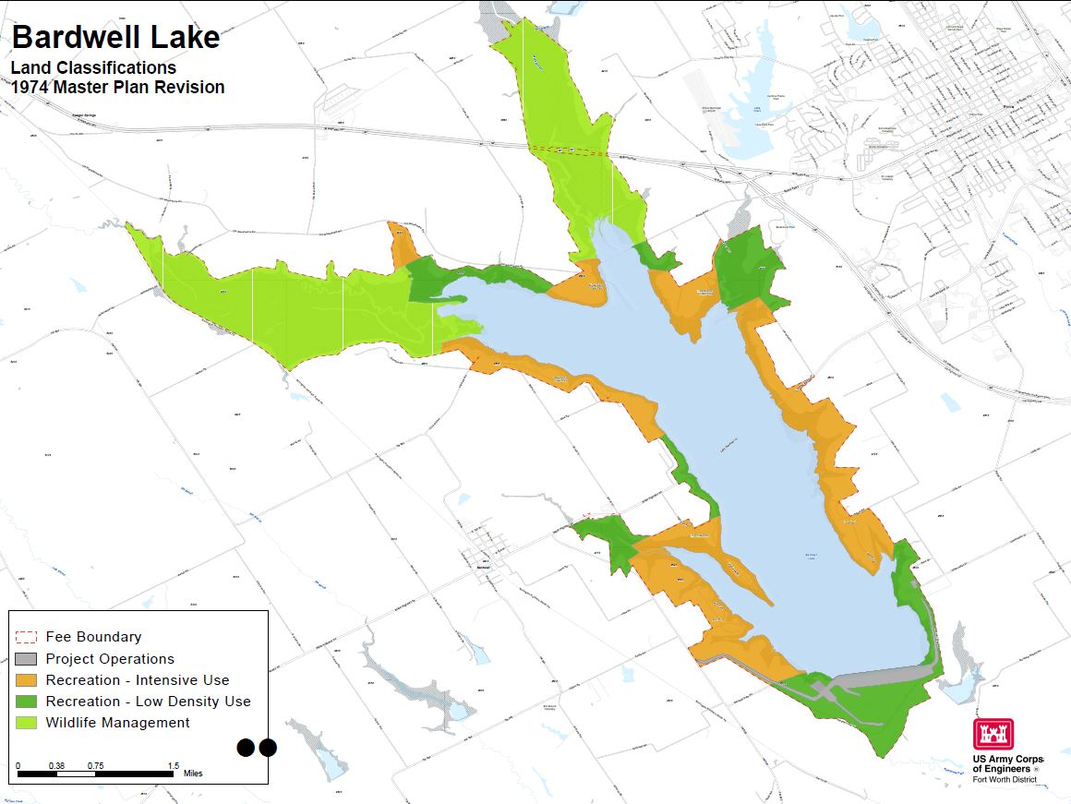
What is the revision process?
Land Use Map from 1974 Master Plan
Notes:
This is the original land use planning map from the 1974 Master Plan available to download on the informational website.

Slide 11
What is the revision process?
NEPA Compliance
National Environmental Policy Act (NEPA)
Purpose of NEPA is to:
Ensure federal agencies give proper consideration to the environment prior to undertaking a federal action
Involve the Public (scoping) in the decision-making process
Document the process by which agencies make informed decisions
NEPA Scoping Process:
Opportunity for public comments and questions on the potential impacts of proposed federal actions
Includes comments from other federal, state, and local governments, and Tribal Nations
Notes:
NEPA is the National Environmental Policy Act.
Compliance with NEPA is required during the master plan revision process. NEPA is required so that federal agencies give proper consideration to the environment prior to undertaking a federal action. Scoping during NEPA involves the public in the decision-making process, while documenting the process by which federal agencies make informed decision.
The NEPA process provides the public with the opportunity to ask questions and comment on the potential impacts of proposed federal actions. It also includes comments from other federal, state and local governments, and Tribal Nations.

Slide 12
What is not part of a master plan?
Facility design details
Details of daily project administration
Technical aspects of:
Water management for flood risk management
Regional water quality
Water supply
Shoreline management
Water level management
Hydropower
Navigation
Notes:
There are topics of public interest that will not be part of the master plan. The master plan does not include facility designs, daily project administration details, or any technical discussion regarding flood risk management, water quality, water supply, shoreline management, water level management, hydropower, or navigation.

Slide 13
What is changing in the plan?
At this point in the revision process there are no proposed changes
The Corps is requesting written comments for RECOMMENDED changes to the existing master plan
Possible Changes to the Revised Mater Plan Could Include:
Change Land and Water Classification
Change Resource Goals and Objectives
Create Utility Corridors
Notes:
The master plan will be changing from the current master plan.
However, at this point in the Scoping Phase of the process, nothing has been proposed to change. Scoping is where the federal agency asks for initial input from other agencies, citizens, and organizations regarding project area, resources and uses. The purpose of this public involvement presentation is to inform the Public that the master plan revision has started and collect suggestions and written comment for possible changes to the master plan. Possible changes could include land and water classifications, resource goals and objectives, the creation of utility corridors, and the inclusion of the mitigation area into the main body of the master plan document.

Slide 14
How can I participate?
Submit written comments!
Review all documents available on the USACE website:
https://www.swf.usace.army.mil/About/Lakes-and-Recreation-Information/Master-Plan-Updates/Bardwell/
Documents available on the website include:
Master Plan documents
Project maps
Comment form
Presentation
Spread the word by telling your colleagues, friends and neighbors to participate
Notes:
You can participate in the process by reviewing the documents available on the website and submit written comments. The Corps will only accept comments in written format. The project website is hosting all the documents relevant to the master plan revision, including the current master plan documents, project maps, comment forms with instructions on how to submit a comment, and copies of this presentation for your review. As the project progresses, and new information is developed, it will be posted to this project website, so you may want to bookmark the site for future reference.
We are asking for your help to spread the word to others, letting them know the master plan revision has been initiated, and this is the opportunity to participate in the process.

Slide 15
How can I participate?
Comments will be accepted only in writing, some of the methods for submitting a comment include:
You may download the comment form provided on the website, fill it out electronically, and email it to the Corps using the submit button on the comment form
Or you may print the comment form provided on the website, fill it out by hand, and mail it to the Corps at the address on the comment form
Or you may write a comment or send an email without using the comment form, and mail or email it to the Corps at the address provided on the website
Comments are due by close of business on March 17, 2023
Notes:
The Corps can accept any form of written comments and we have provided a few methods that may make it easier to submit.
A comment form has been prepared and is available on the website which you can download and fill out electronically. Hit the submit button on the form, and it will autofill the email address, and you can send it in.
Another method is to print the comment form provided on the website and fill it out by hand, or electronically, and mail it into the Corps.
Or you can write a comment in a letter, or email, and send it in. You don’t have to use the comment form.
We will except all of these methods, and any other, as long as it’s a written comment.
The comment period is open for 30 calendar days from the initial announcement.

Slide 16
Who can I talk to about the plan?
Talk to anyone from the USACE at the meeting to answer your questions.
Call the Lake Office at: (972) 875-5711
Visit the Lake Office at: 4000 Observation Drive Ennis, Texas 75119
Email us your questions at: ceswf-od-br@usace.army.mil
Notes:
If you have questions regarding the master plan, please call or email the following Corps project office or district staff.
You can also send questions to the Email address setup for this project as listed on this slide.
If you need to review a printed copy of the information, please contact the lake office to make your request.

Slide 17
When will the master plan be done?
The master plan will take 18-24 months to complete
Projected milestones/schedule
Milestones | Schedule
Public Notification for Scoping | 16 February 2023
Public Comment Period (30 days) | 16 February – 17 March 2023
Draft Master Plan/EA Public Notification | April 2024*
Public Comment Period (30 days) | May 2024*
Final Master Plan/EA Approved | November 2024*
* Projected
Notes:
The master plan will take 18-24 months to complete.
Public notification for scoping initiated on February 16, 2023. The 30-day comment period when written comment are accepted will remain open until March 17, 2023.
The draft document is scheduled to be available for public review by September 2023 followed by a public comment period.
The final approved master plan and EA is scheduled for April 2024.

Slide 18
Thank you for viewing this presentation and participating in the master plan revision process at Bardwell Lake.
Website address:
https://www.swf.usace.army.mil/About/Lakes-and-Recreation-Information/Master-Plan-Updates/Bardwell/
Email:
ceswf-od-br@usace.army.mil
Mail:
U.S. Army Corps of Engineers Bardwell Project Office, Attn: Lake Manager 4000 Observation Drive
Ennis, Texas 75119
Notes:
Thank you for viewing this presentation and participating in the master plan revision process Bardwell Lake.
Project documents are available at this website.
Please send your comments to the Email address, or Bardwell Project Office Address listed here.
Thank you.

